Slide 1
Moving Data

Slide 2
Objectives
After completing this lesson, you should be able to:
  Describe ways to move data
  Create and use directory objects
  Use SQL*Loader to load data from a non-Oracle database (or user files)
  Use external tables to move data via platform-independent files
  Explain the general architecture of Oracle Data Pump
  Use Data Pump Export and Import to move data between Oracle databases
Notes:
Oracle Database 11g: Administration Workshop I 17 - <number>

Slide 3
Moving Data:
General Architecture
SQL*Loader
(sqlldr)
Other clients
expdp
impdp
Data Pump
DBMS_DATAPUMP
Data/Metadata Movement Engine
Oracle
Loader
Oracle
DataPump
Direct Path API
Metadata API
External Table API
Notes:
Oracle Database 11g: Administration Workshop I 17 - <number>
Moving Data: General Architecture
Major functional components:
DBMS_DATAPUMP: Contains the API for high-speed export and import utilities for bulk data and metadata movement
Direct Path API (DPAPI): Oracle Database 11g supports a Direct Path API interface that minimizes data conversion and parsing at both unload and load time.
DBMS_METADATA: Used by worker processes for all metadata unloading and loading. Database object definitions are stored using XML rather than SQL.
External Table API: With the ORACLE_DATAPUMP and ORACLE_LOADER access drivers, you can store data in external tables (that is, in platform-independent files). The SELECT statement reads external tables as though they were stored in an Oracle database.
SQL*Loader: Has been integrated with external tables, providing automatic migration of loader control files to external table access parameters
expdp and impdp: Thin layers that make calls to the DBMS_DATAPUMP package to initiate and monitor Data Pump operations
Other clients: Applications (such as Database Control, replication, transportable tablespaces, and user applications) that benefit from this infrastructure. SQL*Plus may also be used as a client of DBMS_DATAPUMP for simple status queries against ongoing operations.

Slide 4
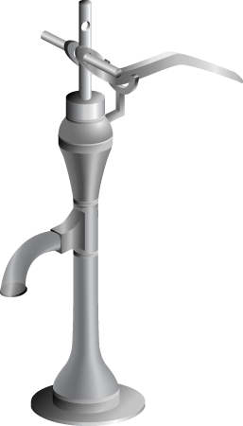
Oracle Data Pump: Overview
As a server-based facility for high-speed data and metadata movement, Oracle Data Pump:
  Is callable via DBMS_DATAPUMP
  Provides the following tools:
    expdp
    impdp
    Web-based interface
  Provides four data movement methods:
    Data file copying
    Direct path
    External tables
    Network link support
  Detaches from and reattaches to long-running jobs
  Restarts Data Pump jobs
Notes:
Oracle Database 11g: Administration Workshop I 17 - <number>
Oracle Data Pump: Overview
Oracle Data Pump enables very high-speed data and metadata loading and unloading of Oracle databases. The Data Pump infrastructure is callable via the DBMS_DATAPUMP PL/SQL package. Thus, custom data movement utilities can be built by using Data Pump.
Oracle Database 11g provides the following tools:
Command-line export and import clients called expdp and impdp, respectively
A Web-based export and import interface that is accessible from Database Control
Data Pump automatically decides the data access methods to use; these can be either direct path or external tables. Data Pump uses direct path load and unload when a table’s structure allows it and when maximum single-stream performance is desired. However, if there are clustered tables, referential integrity constraints, encrypted columns, or a number of other items, Data Pump uses external tables rather than direct path to move the data.
The ability to detach from and reattach to long-running jobs without affecting the job itself enables you to monitor jobs from multiple locations while they are running. All stopped Data Pump jobs can be restarted without loss of data as long as the metainformation remains undisturbed. It does not matter whether the job is stopped voluntarily or involuntarily due to a crash.

Slide 5
Oracle Data Pump: Benefits
Data Pump offers many benefits and some new features over earlier data movement tools, such as:
  Fine-grained object and data selection
  Explicit specification of database version
  Parallel execution
  Estimation of export job space consumption
  Network mode in a distributed environment
  Remapping capabilities
  Data sampling and metadata compression
  Compression of data during a Data Pump export
  Security through encryption
  Ability to export XMLType data as CLOBs
  Legacy mode to support old import and export files
Notes:
Oracle Database 11g: Administration Workshop I 17 - <number>
Oracle Data Pump: Benefits
The EXCLUDE, INCLUDE, and CONTENT parameters are used for fine-grained object and data selection.
You can specify the database version for objects to be moved (using the VERSION parameter) to create a dump file set that is compatible with a previous release of the Oracle database that supports Data Pump.
You can use the PARALLEL parameter to specify the maximum number of threads of active execution servers operating on behalf of the export job.
You can estimate how much space an export job would consume (without actually performing the export) by using the ESTIMATE_ONLY parameter.
Network mode enables you to export from a remote database directly to a dump file set. This can be done by using a database link to the source system.
During import, you can change the target data file names, schemas, and tablespaces.
In addition you can specify a percentage of data to be sampled and unloaded from the source database when performing a Data Pump export. This can be done by specifying the SAMPLE parameter.
You can use the COMPRESSION parameter to indicate whether the metadata should be compressed in the export dump file so that it consumes less disk space. If you compress the metadata, it is automatically uncompressed during import.

Slide 6
Notes:
Oracle Database 11g: Administration Workshop I 17 - <number>
Data Pump Enhancements in Oracle Database 11g
In Oracle Database 11g, new features have been added that enable you to:
Compress both data and metadata, only data, only metadata, or no data during an export
Specify additional encryption options in the following areas:
You can choose to encrypt both data and metadata, only data, only metadata, no data, or only encrypted columns during an export.
You can specify a specific encryption algorithm to use during an export.
You can specify the type of security to use for performing encryption and decryption during an export. For example, perhaps the dump file set will be imported into a different or remote database and it must remain secure in transit. Or perhaps the dump file set will be imported onsite using the Oracle Encryption Wallet but it may also need to be imported offsite where the Oracle Encryption Wallet is not available.
Perform table mode exports and imports using the transportable method; specify how partitioned tables should be handled during import operations
Overwrite existing dump files during an export operation
Rename tables during an import operation
Specify that a data load should proceed even if nondeferred constraint violations are encountered (This is valid only for import operations that use the external tables access method.)
Specify that XMLType columns are to be exported in uncompressed CLOB format regardless of the XMLType storage format that was defined for them
During an export, specify a remap function that takes as a source the original value of the designated column and returns a remapped value that will replace the original value in the dump file
Remap data as it is being imported into a new database
Legacy mode to support the use of original Export (exp) and Import (imp) scripts

Slide 7
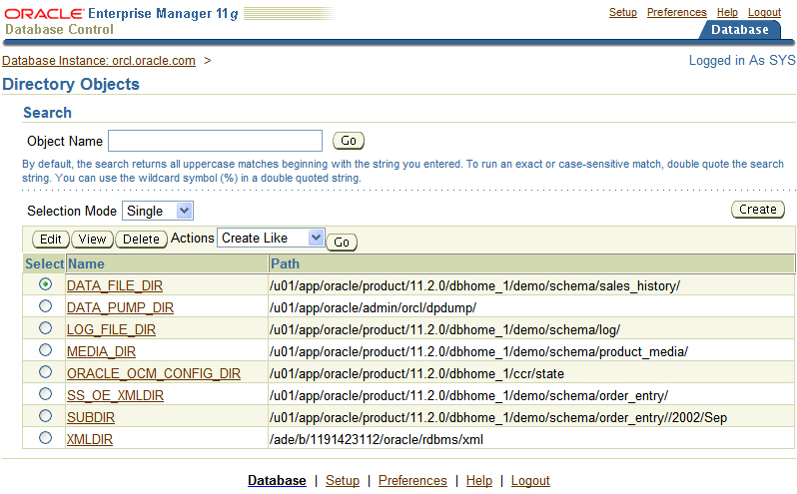
Directory Objects for Data Pump
Notes:
Oracle Database 11g: Administration Workshop I 17 - <number>
Directory Objects for Data Pump
Directory objects are logical structures that represent a physical directory on the server’s file system. They contain the location of a specific operating system directory. This directory object name can be used in Enterprise Manager so that you do not need to hard-code directory path specifications. You thus get greater file management flexibility. Directory objects are owned by the SYS user. Directory names are unique across the database because all the directories are located in a single name space (that is, SYS).
Directory objects are required when you specify file locations for Data Pump because it accesses files on the server rather than on the client.
In Enterprise Manager, select Schema > Database Objects > Directory Objects.
To edit or delete a directory object, select the object and click the appropriate button.

Slide 8
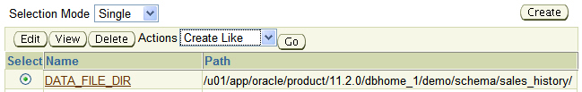
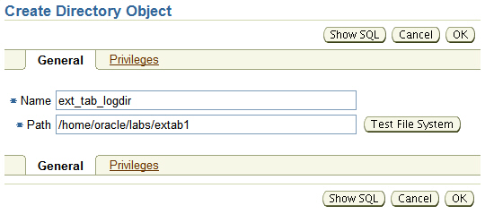
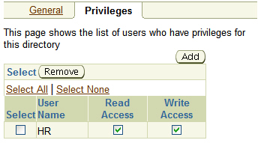
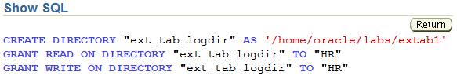
Creating Directory Objects
1
3
5
2
4
Notes:
Oracle Database 11g: Administration Workshop I 17 - <number>
Creating Directory Objects
1. On the Directory Objects page, click the Create button.
2. Enter the name of the directory object and the OS path to which it maps. OS directories should be created before they are used. You can test this by clicking the Test File System button. For the test, provide the host login credentials (that is, the OS user who has privileges on this OS directory).
3. Permissions for directory objects are not the same as OS permissions on the physical directory on the server file system. You can manage user privileges on individual directory objects. This increases the level of security and gives you granular control over these objects. On the Privileges page, click Add to select the user to which you give read or write privileges (or both).
4. Click Show SQL to view the underlying statements. Click Return when finished.
5. Click OK to create the object.

Slide 9
Data Pump Export and Import Clients: Overview
expdp
client
Database
link
Source
Target
Data Pump
job
Server
process
Database
Database
Master
table
Dump
file set
Dump
file set
Master
table
“Network mode”
Server
process
Data Pump
job
impdp
client
Notes:
Oracle Database 11g: Administration Workshop I 17 - <number>
Data Pump Export and Import Clients: Overview
Data Pump Export is a utility for unloading data and metadata into a set of operating system files called dump file sets. Data Pump Import is used to load metadata and data stored in an export dump file set into a target system.
The Data Pump API accesses its files on the server rather than on the client.
These utilities can also be used to export from a remote database directly to a dump file set, or to load the target database directly from a source database with no intervening files. This is known as network mode. This mode is particularly useful to export data from a read-only source database.
At the center of every Data Pump operation is the master table (MT), which is a table created in the schema of the user running the Data Pump job. The MT maintains all aspects of the job. The MT is built during a file-based export job and is written to the dump file set as the last step. Conversely, loading the MT into the current user’s schema is the first step of a file-based import operation and is used to sequence the creation of all objects imported.
Note: The MT is the key to Data Pump’s restart capability in the event of a planned or unplanned stopping of the job. The MT is dropped when the Data Pump job finishes normally.

Slide 10

Data Pump Utility: Interfaces and Modes
  Data Pump Export and Import interfaces:
    Command line
    Parameter file
    Interactive command line
    Enterprise Manager
  Data Pump Export and Import modes:
    Full
    Schema
    Table
    Tablespace
    Transportable tablespace
Notes:
Oracle Database 11g: Administration Workshop I 17 - <number>
Data Pump Utility: Interfaces and Modes
You can interact with Data Pump Export and Import by using one of the following interfaces:
Command line interface: Enables you to specify most of the export parameters directly on the command line
Parameter file interface: Enables you to specify all command line parameters in a parameter file. The only exception is the PARFILE parameter.
Interactive-command interface: Stops logging to the terminal and displays the export or import prompts, where you can enter various commands. This mode is enabled by pressing [Ctrl] + [C] during an export operation that is started with the command line interface or the parameter file interface. Interactive-command mode is also enabled when you attach to an executing or stopped job.
Web interface: On the Database Control home page, click the Data Movement tab, and then select one of the following links from the Move Row Data region: Export to Export Files, Import from Export Files, or Import from Database.
Data Pump Export and Import provide different modes for unloading and loading different portions of the database. The mode is specified on the command line by using the appropriate parameter. The available modes are listed in the slide and are the same as in the original export and import utilities.

Slide 11
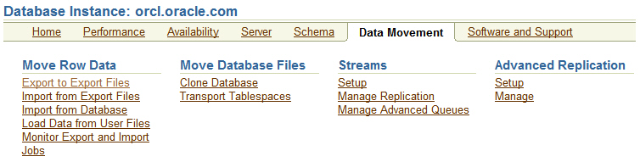
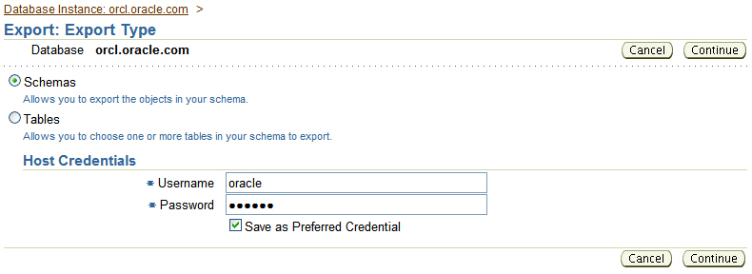
Data Pump Export using Database Control
Notes:
Oracle Database 11g: Administration Workshop I 17 - <number>
Data Pump Export Using Database Control
Enterprise Manager Database control provides a wizard to guide you through the process of performing a Data Pump export and import procedure. The example above shows a Data Pump export.
From the Database Instance home page, click the Data Movement tab, and locate the Data Pump export and import options under the "Move Row Data" section of the web page. Click "Export to Export Files" to being a Data Pump export session.
The next window to appear is the selection of export type. If a privileged user is connect to the database instance, then the export types include the following:
Database
Schemas
Tables
Tablespace
If a non-administrative account is used, then the export type list is limited to the following:
Schemas
Tables
Click Continue to proceed with the export.

Slide 12
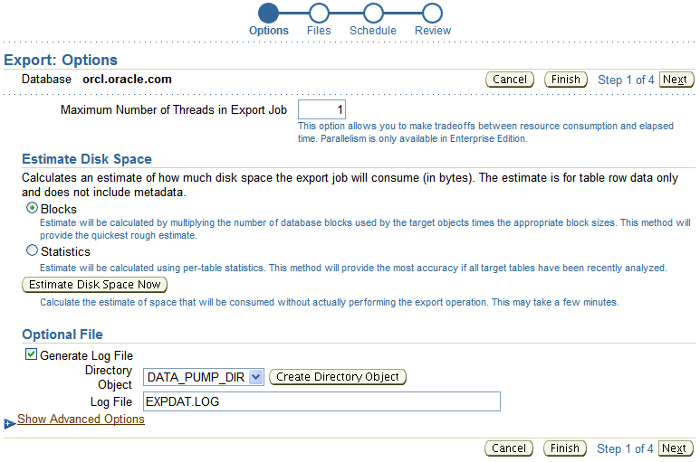
Data Pump Export Example: Basic Options
Notes:
Oracle Database 11g: Administration Workshop I 17 - <number>
Data Pump Export Example: Basic Options
The Options page displays configurable options for the Data Pump export job. The "Maximum Number of Threads in Export Job" entry corresponds to the PARALLEL parameter on the command line. The value you specify should be less than, or equal to, the number of files in the dump file set. This option determines the number of parallel I/O server processes that are used, but the master control process and worker processes acting as query coordinators in parallel query operations do not count toward this total.
An estimation of how much disk space the export job will consume (in bytes) will be printed on the standard output and log file. The estimation can be based on block counts multiplied by block sizes or based on recent statistics analysis. This option corresponds to the ESTIMATE command line parameter.
An optional log file can be specified for the export job for all messages regarding work in progress, work completed, and errors encountered. The user performing the export will need write permissions on the directory object specified for the log file. If the log file being specified already exists, it will be overwritten. This option corresponds to the LOGFILE parameter on the command line.

Slide 13
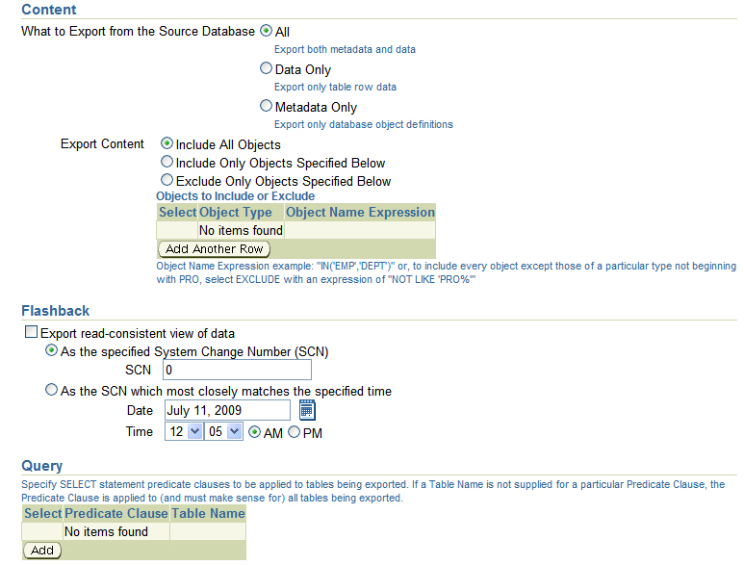
Data Pump Export Example: Advanced Options
Notes:
Oracle Database 11g: Administration Workshop I 17 - <number>
Data Pump Export Example: Advanced Options
Advanced options can be displayed by clicking the "Show Advanced Options" link.
The "Content" section of the page enables you to filter what export unloads: data only, metadata only, or both. This option corresponds to the CONTENT command line parameter. The "Content" section also allows for the INCLUDE and EXCLUDE command line parameters to be specified.
The EXCLUDE parameter enables any database object type to be excluded from an export or import operation. The optional name qualifier enables you to have finer selectivity within each object type that is specified, as in these examples:
EXCLUDE=VIEW
EXCLUDE=PACKAGE
EXCLUDE=INDEX:"LIKE 'EMP%'"
The INCLUDE parameter includes only the specified object types and objects in an operation.
Syntax: INCLUDE = object_type[:"name_expr"]
Flashback query can be used when data is being exported.
The QUERY parameter operates in a similar manner as the original export utility, with two significant enhancements: It can be qualified with a table name so that it applies to only that table, and it can be used during import as well. Here is an example:
QUERY=hr.employees:"WHERE department_id in (10,20)

Slide 14
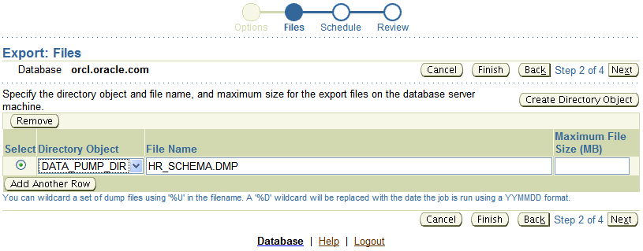
Data Pump Export Example: Files
Notes:
Oracle Database 11g: Administration Workshop I 17 - <number>
Data Pump Export Example: Files
The DUMPFILE parameter specifies the names and (optionally) directories of disk-based dump files. Multiple file specifications may be provided as a comma-separated list or in separate DUMPFILE parameter specifications. File names may contain the substitution variable %U, which implies that multiple files may be generated. %U is expanded in the resulting file names into a two-character, fixed-width, monotonically increasing integer starting at 01. If no DUMPFILE is specified, expdat.dmp is used by default. Created dump files are autoextensible by default.
If FILESIZE is specified, each file is FILESIZE bytes in size and nonextensible. If more dump space is required and a template with %U has been supplied, a new file is automatically created with FILESIZE bytes; otherwise, the client receives a message to add a new file.
If a template with %U is specified, the number of files that are initially created is equal to the PARALLEL parameter.
Preexisting files that match the resulting file names are not overwritten by default. Instead, they result in an error and cause the job to be aborted. If you want the files to be overwritten then set REUSE_DUMPFILES=Y. Click Next to proceed with the export.
Note: If multiple dump file templates are provided, they are used to generate dump files in a circular fashion.

Slide 15
Notes:
Oracle Database 11g: Administration Workshop I 17 - <number>
Data Pump Export Example: Files (continued)
You do not need to create a directory object manually before using Data Pump Export.
A default directory object named DATA_PUMP_DIR is created for every database, whether newly created or upgraded by a script on UNIX or Windows platforms. Access to the DATA_PUMP_DIR directory is granted automatically to the EXP_FULL_DATABASE and IMP_FULL_DATABASE roles. The DATA_PUMP_DIR directory is created in one of the following locations:
<ORACLE_BASE>/admin/DB_UNIQUE_NAME/dpdump
<ORACLE_HOME>/admin/DB_UNIQUE_NAME/dpdump
The exact directory path specification for DATA_PUMP_DIR varies depending on the value of the ORACLE_BASE and ORACLE_HOME system environment variables and on the existence of the DATA_PUMP_DIR subdirectory. If ORACLE_BASE is defined on the target system, that value is used. Otherwise, the value of ORACLE_HOME is used. If the DATA_PUMP_DIR subdirectory is for some reason not found, the following default path is used:
ORACLE_HOME/rdbms/log
Note: In all cases, you must have the appropriate access privileges to the directory object for the attempted operation. For export, you need write access for all files; for import, you need read access for dump files and write access for log files and SQL files.

Slide 16
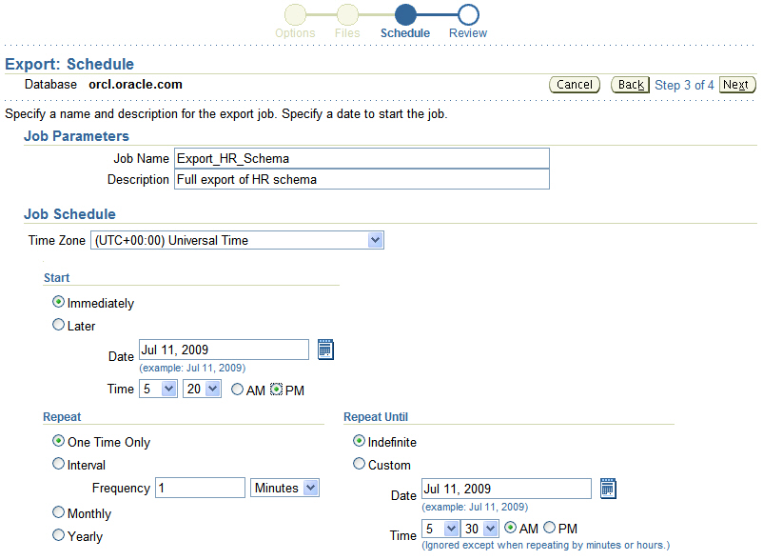
Data Pump Export Example: Schedule
Notes:
Oracle Database 11g: Administration Workshop I 17 - <number>
Data Pump Export Example: Schedule
Data Pump jobs (created through this wizard) can be scheduled as repeatable jobs by Enterprise Manager Database Control. If the Job Name is not specified, a system-generated name will be used. Click Next to proceed with the export.

Slide 17
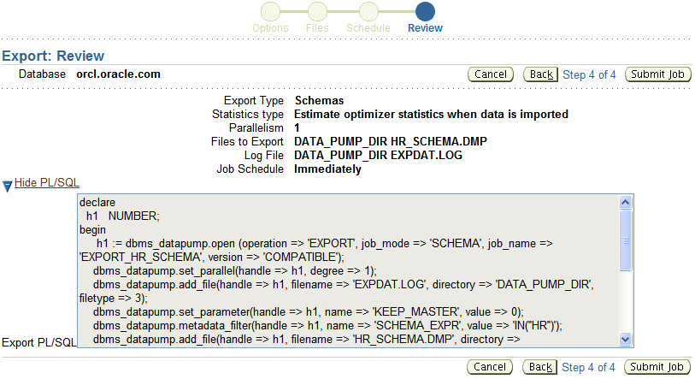
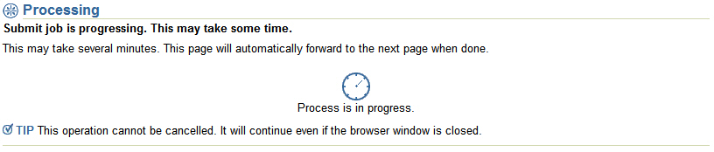
Data Pump Export Example: Review
Notes:
Oracle Database 11g: Administration Workshop I 17 - <number>
Data Pump Export Example: Review
The "Review" page displays a summary of the information entered and allows you to view to PL/SQL procedure syntax that will be used for the export job. Click the "Submit Job" button to continue. Once the job is submitted, it cannot be cancelled and it is safe to close the browser.

Slide 18
Data Pump Import Example: impdp
Data Pump can be invoked on the command line to allow further command line options to be specified.
$ impdp hr DIRECTORY=DATA_PUMP_DIR \ DUMPFILE=HR_SCHEMA.DMP \
PARALLEL=1 \
CONTENT=ALL \
TABLES="EMPLOYEES" \
LOGFILE=DATA_PUMP_DIR:import_hr_employees.log \
JOB_NAME=importHR \
TRANSFORM=STORAGE:n
Notes:
Oracle Database 11g: Administration Workshop I 17 - <number>
Data Pump Import Example: impdp
Data Pump provides command line clients for import and export operations. The example above illustrates a Data Pump import using the impdp utility. When running Data Pump using the command line, more options are provided. For a complete list of options, please consult the documentation manual "Oracle Database Utilities 11g Release 2 (11.2)."

Slide 19
Data Pump Import: Transformations
You can remap:
  Data files by using REMAP_DATAFILE
  Tablespaces by using REMAP_TABLESPACE
  Schemas by using REMAP_SCHEMA
  Tables by using REMAP_TABLE
  Data by using REMAP_DATA
REMAP_TABLE = 'EMPLOYEES':'EMP'
Notes:
Oracle Database 11g: Administration Workshop I 17 - <number>
Data Pump Import: Transformations
Because object metadata is stored as XML in the dump file set, it is easy to apply transformations when DDL is being formed during import. Data Pump Import supports several transformations:
REMAP_DATAFILE is useful when moving databases across platforms that have different file-system semantics.
REMAP_TABLESPACE enables objects to be moved from one tablespace to another.
REMAP_SCHEMA provides the old FROMUSER /TOUSER capability to change object ownership.
REMAP_TABLE provides the ability to rename entire tables.
REMAP_DATA provides the ability to remap data as it is being inserted.

Slide 20
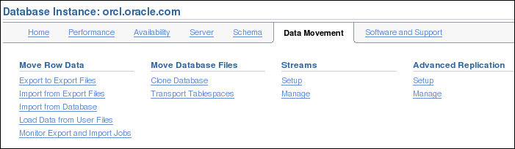
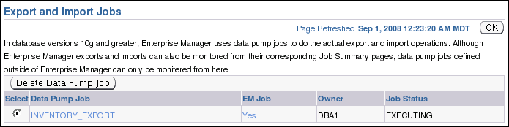
Using Enterprise Manager to Monitor
Data Pump Jobs
Notes:
Oracle Database 11g: Administration Workshop I 17 - <number>
Using Enterprise Manager to Monitor Data Pump Jobs
You can use the Enterprise Manager graphical user interface (GUI) to monitor all Data Pump jobs, including those created by using the expdp or impdp command line interfaces or by using the DBMS_DATAPUMP package.
You can view the current status of the job and change the status to EXECUTE, STOP, or SUSPEND.
To access the “Export and Import Jobs” page, click the “Monitor Export and Import Jobs” link in the Move Row Data region on the Maintenance page.

Slide 21
Migration with Data Pump Legacy Mode
  Assistance in transitioning from imp and exp utilities to impdp and expdp utilities
  Data Pump in legacy mode:
    1. Encounters unique imp or exp parameter and enters legacy mode
    2. Attempts to map the old syntax to the new syntax
    3. Displays new syntax
    4. Exits legacy mode
Best practice tip: Oracle strongly recommends that you view the new syntax and make script changes as time permits.
Notes:
Oracle Database 11g: Administration Workshop I 17 - <number>
Migration with Data Pump Legacy Mode
Because of the extensive use of import and export scripts, Oracle Database 11g Release 2 provides migration assistance with Data Pump legacy mode. The Data Pump utilities:
1. Enter legacy mode if a parameter unique to exp/imp is present, either on the command line or in a script
2. Map the old parameter to the equivalent expdp or impdp parameter (if possible)
3. Display the converted command, so that you can view the new syntax and make script changes, as your time permits
4. Exit legacy mode, if a mix of old and new parameters are present (Mixing a Data Pump parameter with an original export or import parameter causes Data Pump to exit without performing the desired task.)
For additional new features, see Oracle Database Utilities 11g Release 2.

Slide 22
Data Pump Legacy Mode
The Data Pump export and import utilities:
  Read and write files only in Data Pump format
  Accept exp and imp utility commands in legacy mode
  Include legacy mode parameters that:
    Can be identical to the new syntax:
        FILESIZE=integer[B | K | M | G]
    Can be similar:
        QUERY= query_clause
    Are ignored, when the command is superceded by Data Pump defaults
        BUFFER=integer
        COMPRESS={y|n}
        DIRECT={y|n}
    Cause an error when old and new syntax is mixed
Notes:
Oracle Database 11g: Administration Workshop I 17 - <number>
Data Pump Legacy Mode
The Data Pump utilities operate only with files in the Data Pump format. (Files created by the exp utility must be read by the imp utility.) The Data Pump legacy mode allows you to continue the use of your existing scripts with the Data Pump utilities. But you must use the new Data Pump syntax, if you want to access new features of the database.
When the utilities find unique exp or imp parameters, they enter legacy mode.
Identical parameters are used unchanged. Example: The FILESIZE=integer[B | K | M | G] parameter specifies the maximum size of a dump file.
The QUERY=query_clause parameter does not cause any conversion, but note that the expdp utility handles queries less restrictive than the deprecated export utility. So your query results may be a little different.
Some parameters are ignored, because they are superceded by new defaults. Examples:
The BUFFER=integer parameter is ignored, because the expdp utility has no conventional path mode.
The COMPRESS={y|n} parameter is ignored, because the expdp utility has no equivalent parameter.
The DIRECT={y|n} parameter is ignored, because the expdp utility determines if the requested export should use direct path or external table mode.
A mixture of exp/imp and Data Pump parameters causes a job to fail.

Slide 23
Data Pump Legacy Mode
  Legacy mode parameters:
    Are mapped to Data Pump parameters, if possible:
        consistent={y|n} -> FLASHBACK_TIME
        GRANTS=n -> EXCLUDE=CONSTRAINTS
        INDEXES=n -> EXCLUDE=INDEX
        LOG=filename -> LOGFILE=filename
        FILE=filename -> dumpfile=directory-object:filename
    Can be similar, but not identical:
        FEEDBACK=integer -> STATUS
    Cause an error when incompatible with new Data Pump:
        VOLSIZE=integer
Notes:
Oracle Database 11g: Administration Workshop I 17 - <number>
Data Pump Legacy Mode (continued)
Use the Data Pump legacy mode to transition deprecated scripts to the current version. Several parameters can be mapped to the new syntax:
Data Pump knows the current time and maps the CONSISTENT={y|n} parameter to the FLASHBACK_TIME parameter.
The GRANTS=n parameter is remapped to EXCLUDE=GRANT.
The INDEXES=n parameter is remapped to EXCLUDE=INDEX.
The LOG=filename parameter is remapped to LOGFILE=filename. The contents of the log file (informational and error messages) are in the expdp format.
The FILE=filename parameter is remapped to dumpfile=directory-object:filename. But if the expdp utility cannot find the path to an existing directory object, it aborts.
A parameter can be mapped, but the new functionality is different. The FEEDBACK=integer parameter is remapped to STATUS. It is not a direct mapping because the status of the export job, not just the number of processed rows, is returned.
A parameter can cause the job to abort, because it is incompatible with Data Pump. The VOLSIZE=integer parameter of the exp utility specifies the tape volume size. Data Pump does not work with tape drives; Oracle Secure Backup manages tapes.
For a complete mapping of exp and imp parameters to the Data Pump utilities, see Oracle Database Utilities 11g Release 2.

Slide 24
Managing File Locations
  Original exp and imp utilities: Fully qualified file names
  Data Pump directory object for file locations
    Default (in prior versions): DATA_PUMP_DIR parameter
    New optional DATA_PUMP_DIR_schema-name directory object
    Managed with the CREATE DIRECTORY and GRANT SQL commands
    Default location (independent of legacy mode), when:
      Command line without DIRECTORY parameter
      User without EXP_FULL_DATABASE privilege
Notes:
Oracle Database 11g: Administration Workshop I 17 - <number>
Managing File Locations
The original and the Data Pump utilities differ in their handling of file locations, because the original utilities were client based (all file names were fully qualified).
The Data Pump utilities are server based. They require that a directory object is used when specifying file locations. The directory object must be accessible to the schema. The default location in prior versions was set by the DATA_PUMP_DIR initialization parameter.
This functionality does not introduce new mandatory DBA tasks. It introduces an optional DATA_PUMP_DIR_<schema-name> directory object. If you choose to create this directory object with the CREATE DIRECTORY and GRANT SQL commands, you allow the specified schemas the ability to use Data Pump export or import (which will have an impact on the usual server resources such as CPU, memory usage, and disk usage).
The Data Pump utilities use this directory object when none is specified in the command line and when the user does not have the EXP_FULL_DATABASE privilege. This is independent of the legacy mode.

Slide 25

SQL*Loader: Overview
Input data files
Control file
SQL*Loader
Rejected
Field processing
Discarded
Accepted
Record selection
Selected
Bad file
Oracle server
Discard file
(optional)
Rejected
Inserted
Log file
Notes:
Oracle Database 11g: Administration Workshop I 17 - <number>
SQL*Loader: Overview
SQL*Loader loads data from external files into tables of an Oracle database. It has a powerful data parsing engine that puts little limitation on the format of the data in the data file.
SQL*Loader uses the following files:
Input data files: SQL*Loader reads data from one or more files (or operating system equivalents of files) that are specified in the control file. From SQL*Loader’s perspective, the data in the data file is organized as records. A particular data file can be in fixed record format, variable record format, or stream record format. The record format can be specified in the control file with the INFILE parameter. If no record format is specified, the default is stream record format.
Control file: The control file is a text file that is written in a language that SQL*Loader understands. The control file indicates to SQL*Loader where to find the data, how to parse and interpret the data, where to insert the data, and so on. Although not precisely defined, a control file can be said to have three sections.
The first section contains such session-wide information as the following:
Global options, such as the input data file name and records to be skipped
INFILE clauses to specify where the input data is located
Data to be loaded

Slide 26
Notes:
Oracle Database 11g: Administration Workshop I 17 - <number>
SQL*Loader: Overview (continued)
The second section consists of one or more INTO TABLE blocks. Each of these blocks contains information about the table (such as the table name and the columns of the table) into which the data is to be loaded.
The third section is optional and, if present, contains input data.
Log file: When SQL*Loader begins execution, it creates a log file. If it cannot create a log file, execution terminates. The log file contains a detailed summary of the load, including a description of any errors that occurred during the load.
Bad file: The bad file contains records that are rejected, either by SQL*Loader or by the Oracle database. Data file records are rejected by SQL*Loader when the input format is invalid. After a data file record is accepted for processing by SQL*Loader, it is sent to the Oracle database for insertion into a table as a row. If the Oracle database determines that the row is valid, the row is inserted into the table. If the row is determined to be invalid, the record is rejected and SQL*Loader puts it in the bad file.
Discard file: This file is created only when it is needed and only if you have specified that a discard file should be enabled. The discard file contains records that are filtered out of the load because they do not match any record-selection criteria specified in the control file.
For more information about SQL*Loader, see the Oracle Database Utilities guide.

Slide 27
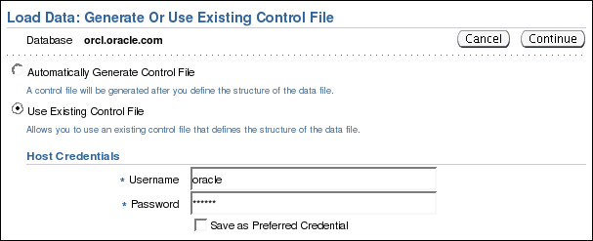
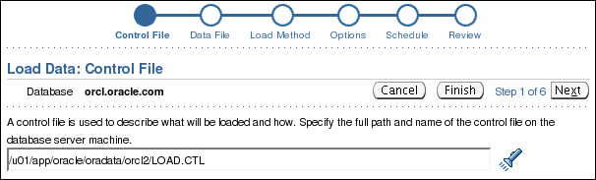
Loading Data with SQL*Loader
Notes:
Oracle Database 11g: Administration Workshop I 17 - <number>
Loading Data with SQL*Loader
Use the “Load Data from User Files Wizard” to load data from a flat file into an Oracle database.
To display the wizard, select Enterprise Manager Data Movement > Move Row Data > Load Data from User Files.

Slide 28

SQL*Loader Control File
The SQL*Loader control file instructs SQL*Loader about:
  Location of the data to be loaded
  Data format
  Configuration details:
    Memory management
    Record rejection
    Interrupted load handling details
  Data manipulation details
Notes:
Oracle Database 11g: Administration Workshop I 17 - <number>
SQL*Loader Control File
The SQL*Loader control file is a text file that contains data definition language (DDL) instructions. DDL is used to control the following aspects of a SQL*Loader session:
Where SQL*Loader finds the data to load
How SQL*Loader expects that data to be formatted
How SQL*Loader is being configured (including memory management, selection and rejection criteria, interrupted load handling, and so on) as it loads the data
How SQL*Loader manipulates the data being loaded

Slide 29
Notes:
Oracle Database 11g: Administration Workshop I 17 - <number>
SQL*Loader Control File (continued)
1 -- This is a sample control file
2 LOAD DATA
3 INFILE ’SAMPLE.DAT’
4 BADFILE ’sample.bad’
5 DISCARDFILE ’sample.dsc’
6 APPEND
7 INTO TABLE emp
8 WHEN (57) = ’.’
9 TRAILING NULLCOLS
10 (hiredate SYSDATE,
deptno POSITION(1:2) INTEGER EXTERNAL(3)
NULLIF deptno=BLANKS,
job POSITION(7:14) CHAR TERMINATED BY WHITESPACE
NULLIF job=BLANKS "UPPER(:job)",
mgr POSITION(28:31) INTEGER EXTERNAL
TERMINATED BY WHITESPACE, NULLIF mgr=BLANKS,
ename POSITION(34:41) CHAR
TERMINATED BY WHITESPACE "UPPER(:ename)",
empno POSITION(45) INTEGER EXTERNAL
TERMINATED BY WHITESPACE,
sal POSITION(51) CHAR TERMINATED BY WHITESPACE
"TO_NUMBER(:sal,’$99,999.99’)",
comm INTEGER EXTERNAL ENCLOSED BY ’(’ AND ’%’
":comm * 100"
)
The explanation of this sample control file (by line numbers) is as follows:
1. Comments can appear anywhere in the command section of the file, but they must not appear in the data. Precede any comment with two hyphens. All text to the right of the double hyphen is ignored until the end of the line.
2. The LOAD DATA statement indicates to SQL*Loader that this is the beginning of a new data load. If you are continuing a load that has been interrupted in progress, use the CONTINUE LOAD DATA statement.
3. The INFILE keyword specifies the name of a data file containing data that you want to load.
4. The BADFILE keyword specifies the name of a file into which rejected records are placed.
5. The DISCARDFILE keyword specifies the name of a file into which discarded records are placed.
6. The APPEND keyword is one of the options that you can use when loading data into a table that is not empty. To load data into a table that is empty, use the INSERT keyword.
7. The INTO TABLE keyword enables you to identify tables, fields, and data types. It defines the relationship between records in the data file and tables in the database.
8. The WHEN clause specifies one or more field conditions that each record must match before SQL*Loader loads the data. In this example, SQL*Loader loads the record only if the 57th character is a decimal point. That decimal point delimits dollars and cents in the field and causes records to be rejected if SAL has no value.
9. The TRAILING NULLCOLS clause prompts SQL*Loader to treat any relatively positioned columns that are not present in the record as null columns.
10. The remainder of the control file contains the field list, which provides information about column formats in the table that is being loaded.

Slide 30
Loading Methods
Data insert
Block
writes
Table
HWM
Conventional Load | Direct Path Load
Uses COMMIT | Uses data saves (faster operation)
Always generates redo entries | Generates redo only under specific conditions
Enforces all constraints | Enforces only PRIMARY KEY, UNIQUE, and NOT NULL
Fires INSERT triggers | Does not fire INSERT triggers
Can load into clustered tables | Does not load into clusters
Allows other users to modify tables during load operation | Prevents other users from making changes to tables during load operation
Maintains index entries on each insert | Merges new index entries at the end of the load
Notes:
Oracle Database 11g: Administration Workshop I 17 - <number>
Comparing Direct and Conventional Path Loads
Method of Saving Data
A conventional path load executes SQL INSERT statements to populate tables in an Oracle database. A direct path load eliminates much of the Oracle database overhead by formatting Oracle data blocks and writing the data blocks directly to the database files. A direct load does not compete with other users for database resources, so it can usually load data at close to disk speed. Conventional path loads use SQL processing and a database COMMIT operation for saving data. The insertion of an array of records is followed by a COMMIT operation. Each data load may involve several transactions.
Direct path loads use data saves to write blocks of data to Oracle data files. This is why the direct path loads are faster than the conventional ones. The following features differentiate a data save from COMMIT:
During a data save, only full database blocks are written to the database.
The blocks are written after the high-water mark (HWM) of the table.
After a data save, the HWM is moved.
Internal resources are not released after a data save.
A data save does not end the transaction.
Indexes are not updated at each data save.

Slide 31




External Tables
External tables are read-only tables stored as files on the operating system outside of the Oracle database.
PGA
Server
process
ORACLE_LOADER
driver
(Text)
ext_table
(Metadata Only)
ORACLE_DATAPUMP
driver
Database
(Binary)
Notes:
Oracle Database 11g: Administration Workshop I 17 - <number>
External Tables
External tables access data in external sources as if it were in a table in the database. You can connect to the database and create metadata for the external table using DDL. The DDL for an external table consist of two parts: one part the describes the Oracle Database column types, and another part that describes the mapping of the external data to the Oracle Database data columns.
An external table does not describe any data that is stored in the database. Nor does it describe how data is stored in the external source. Instead, it describes how the external table layer must present the data to the server. It is the responsibility of the access driver and the external table layer to do the necessary transformations required on the data in the external file so that it matches the external table definition. External tables are read only; therefore, no DML operations are possible, and no index can be created on them.
There are two access driver used with external tables. The ORACLE_LOADER access driver can only be used to read table data from and external table and load it into the database. It uses text files as the data source. The ORACLE_DATAPUMP access driver can both load table data from an external file into the database and also unload data from the database into an external file. It uses binary files as the external files. The binary files have the same format as the files used by the impdp and expdp utilities and can be interchanged with them.

Slide 32


External Table Benefits
  Data can be used directly from the external file or loaded into another database.
  External data can be queried and joined directly in parallel with tables residing in the database, without requiring it to be loaded first.
  The results of a complex query can be unloaded to an external file.
  You can combine generated files from different sources for loading purposes.
From Oracle Database
From external file
Notes:
Oracle Database 11g: Administration Workshop I 17 - <number>
External Table Benefits
The data files created for the external table can be moved and used as the data files for another external table in the same database or different database. External data can be queried and joined directly in parallel to tables residing in the database, without requiring the data to be loaded first. You can choose to have your applications directly access external tables with the SELECT command, or you can choose to have data loaded first into a target database.
The results of a complex query can be unloaded to an external file using the ORACLE_DATAPUMP access driver.
Data files that are populated by different external tables can all be specified in the LOCATION clause of another external table. This provides an easy way of aggregating data from multiple sources. The only restriction is that the metadata for all the external tables must be exactly the same.

Slide 33
Defining an External Tables with ORACLE_LOADER
CREATE TABLE extab_employees
(employee_id NUMBER(4),
first_name VARCHAR2(20),
last_name VARCHAR2(25),
hire_date DATE)
ORGANIZATION EXTERNAL
( TYPE ORACLE_LOADER DEFAULT DIRECTORY extab_dat_dir
ACCESS PARAMETERS
( records delimited by newline
badfile extab_bad_dir:'empxt%a_%p.bad'
logfile extab_log_dir:'empxt%a_%p.log'
fields terminated by ','
missing field values are null
( employee_id, first_name, last_name,
hire_date char date_format date mask "dd-mon-yyyy“))
LOCATION ('empxt1.dat', 'empxt2.dat') )
PARALLEL REJECT LIMIT UNLIMITED;
Notes:
Oracle Database 11g: Administration Workshop I 17 - <number>
Defining an External Table with ORACLE_LOADER
The metadata for an external table is created using the SQL language in the database. The ORACLE_LOADER access driver uses the SQL*Loader syntax to define the external table. This command does not create the external text files.
The example in the slide shows three directory objects (extab_dat_dir, extab_bad_dir, and extab_log_dir) that are created and mapped to existing OS directories to which the user is granted access.
When the table extab_employees is accessed, SQL*Loader functionality is used to load the table, and at that instance the log file and bad file are created.
Best-practice tip: If you have a lot of data to load, enable PARALLEL for the load operation:
ALTER SESSION ENABLE PARALLEL DML;

Slide 34
External Table Population with ORACLE_DATAPUMP
CREATE TABLE ext_emp_query_results
(first_name, last_name, department_name)
ORGANIZATION EXTERNAL
(
TYPE ORACLE_DATAPUMP
DEFAULT DIRECTORY ext_dir
LOCATION ('emp1.exp','emp2.exp','emp3.exp')
)
PARALLEL
AS
SELECT e.first_name,e.last_name,d.department_name
FROM employees e, departments d
WHERE e.department_id = d.department_id AND
d.department_name in
('Marketing', 'Purchasing');
Notes:
Oracle Database 11g: Administration Workshop I 17 - <number>
External Table Population with ORACLE_DATAPUMP
This example shows you how the external table population operation can help to export a selective set of records resulting from the join of the EMPLOYEES and DEPARTMENTS tables.
Because the external table can be large, you can use a parallel populate operation to unload your data to an external table. As opposed to a parallel query from an external table, the degree of parallelism of a parallel populate operation is constrained by the number of concurrent files that can be written to by the access driver. There is never more than one parallel execution server writing into one file at a particular point in time.
The number of files in the LOCATION clause must match the specified degree of parallelism because each input/output (I/O) server process requires its own file. Any extra files that are specified are ignored. If there are not enough files for the specified degree of parallelism, the degree of parallelization is lowered to match the number of files in the LOCATION clause.
The external table is read-only after is has been populated. The SELECT command can be very complex, allowing specific information to be populated in the external table. The external table, having the same file structure as binary data pump files, can then be migrated to another system, and imported with the impdp utility or read as an external table.
Note: For more information about the ORACLE_DATAPUMP access driver parameters, see the Oracle Database Utilities 11g Release 2 (11.2) guide.

Slide 35
Using External Tables
  Querying and external table:
  Querying and joining an external table with an internal table
  Appending data to an internal table from an external table
SQL> SELECT * FROM extab_employees;
SQL> SELECT e.employee_id, e.first_name, e.last_name, d.department_name FROM departments d, extab_employees e
WHERE d.department_id = e.department_id;
SQL> INSERT /*+ APPEND */ INTO hr.employees SELECT * FROM extab_employees;
Notes:
Oracle Database 11g: Administration Workshop I 17 - <number>
Using External Tables
External tables are queried just like internal database tables. The first example illustrates querying an external table EXTAB_EMPLOYEES with only displaying the results. The results are not stored in the database.
The second example shows the joining of an internal table DEPARTMENTS with an external table EXTAB_EMPLOYEES and only displaying the results. The third example on the slide illustrates the direct appending of an internal tables data with the query and load of data from an external table.

Slide 36

Data Dictionary
View information about external tables in:
  [DBA| ALL| USER]_EXTERNAL_TABLES
  [DBA| ALL| USER]_EXTERNAL_LOCATIONS
  [DBA| ALL| USER]_TABLES
  [DBA| ALL| USER]_TAB_COLUMNS
  [DBA| ALL]_DIRECTORIES
Notes:
Oracle Database 11g: Administration Workshop I 17 - <number>
Data Dictionary
The data dictionary views in the slide list the following table information:
[DBA| ALL| USER]_EXTERNAL_TABLES: Specific attributes of external tables in the database
[DBA| ALL| USER]_EXTERNAL_LOCATIONS: Data sources for external tables
[DBA| ALL| USER]_TABLES: Descriptions of the relational tables in the database
[DBA| ALL| USER]_TAB_COLUMNS: Descriptions of the columns of tables, views, and clusters in the database
[DBA| ALL]_DIRECTORIES: Describes the directory objects in the database.

Slide 37
Quiz
Like other database objects, Directory objects are owned by the user that creates them unless another schema is specified during creation.
  True
  False
Notes:
Oracle Database 11g: Administration Workshop I 17 - <number>
Answer: 2

Slide 38
Quiz
An index can be created on an external table.
  True
  False
Notes:
Oracle Database 11g: Administration Workshop I 17 - <number>
Answer: 2

Slide 39
Summary
In this lesson, you should have learned how to:
  Describe ways to move data
  Create and use directory objects
  Use SQL*Loader to load data from a non-Oracle database (or user files)
  Use external tables to move data via
  platform-independent files
  Explain the general architecture of Oracle Data Pump
  Use Data Pump Export and Import to move data between Oracle databases
Notes:
Oracle Database 11g: Administration Workshop I 17 - <number>

Slide 40
Practice 17 Overview:
Moving Data
This practice covers the following topics:
  Using the Data Pump Export Wizard to select database objects to be exported
  Monitoring a Data Pump Export job
  Using the Data Pump Import Wizard to import tables to your database
  Using the Load Data Wizard to load data into your database
  Loading data by using the command line
Notes:
Oracle Database 11g: Administration Workshop I 17 - <number>

